Slide 1
EE 448/648: Antennas and Propagation
Course project by:
Vineet Tripathi
Sagar Joshi
April 24, 2023

Slide 2
Outline
Objective
Introduction
Design candidates
Results and discussion
Conclusion and future work

Slide 3
Objective
To design a dual-band printed antenna radiating around 1.8 and 2.4 GHz in the broadside direction. The feed should be given using a microstrip line. The gain of the antenna in both operating frequencies should be above 3.0 dBi.

Slide 4
Introduction
A. Printed Antennas
A printed antenna is an antenna that is made using printing techniques, such as photolithography, inkjet printing, or screen printing, on a thin material such as copper or silver.
In contrast, a conventional antenna is typically made using specialized manufacturing processes, such as metal casting or CNC machining, to create a 3D structure out of metal.
Printed antennas are much more compact and can be integrated with electronic circuitry.
They can be manufactured using a variety of techniques, making them easy and inexpensive to produce.

Slide 5
Introduction
B. Significance of dual frequency band (1.8 GHz and 2.4 GHz)
The 1.8 GHz (mobile comms.) and 2.4 GHz frequency bands (WLAN) are both commonly used for wireless communication applications, such as Wi-Fi, Bluetooth, and cellular networks.
By having a single antenna that can operate on both frequency bands, devices can be designed with greater flexibility and efficiency. This means that a device equipped with a dual-band antenna can support multiple wireless communication standards, without the need for multiple antennas or additional hardware.

Slide 6
Introduction
C. Microstrip Patch Antenna
Microstrip patch antennas are a popular choice for wireless communication applications due to their low profile, lightweight, and ease of fabrication.
There are several different ways to feed power into a microstrip patch antenna, including coaxial feeding, microstrip line feeding, aperture coupled feeding, etc.
Microstrip feeding involves using a microstrip line to feed power into the antenna, with the feed point located at the edge of the patch. An inset slot is used to improve the impedance matching and return loss.
Advantages of microstrip feeding are its wide bandwidth, better radiation pattern control, and low cost. Disadvantages of microstrip feeding include that it has more complex design and lower gain.

Slide 7
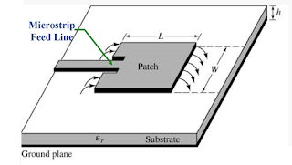
Introduction
C. Microstrip Patch Antenna
L = length of patch
W = width of patch
ε_{r} = relative dielectric constant
of substrate
h = height of substrate
Microstrip antenna with inset-feed line. Source: [1]

Slide 8
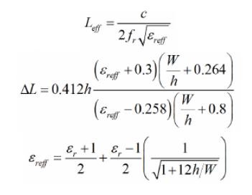
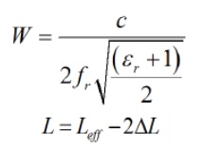
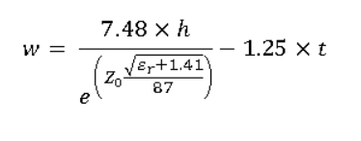
Introduction
C. Microstrip Patch Antenna
Source: [2], [3]
c = Velocity of light
L_{eff} = Effective patch length
ΔL = Length extension
ε_{reff} = Effective dielectric constant
f_{r} = Resonant frequency
h = Height of dielectric substrate
t = Thickness of patch
w = Width of feed
Z₀ = Target Impedance (50 ohms)

Slide 9
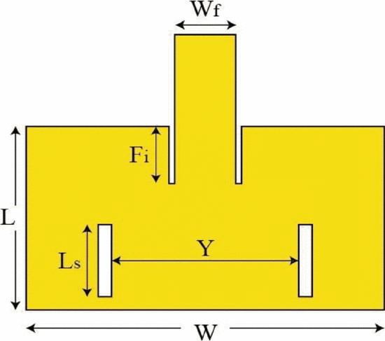
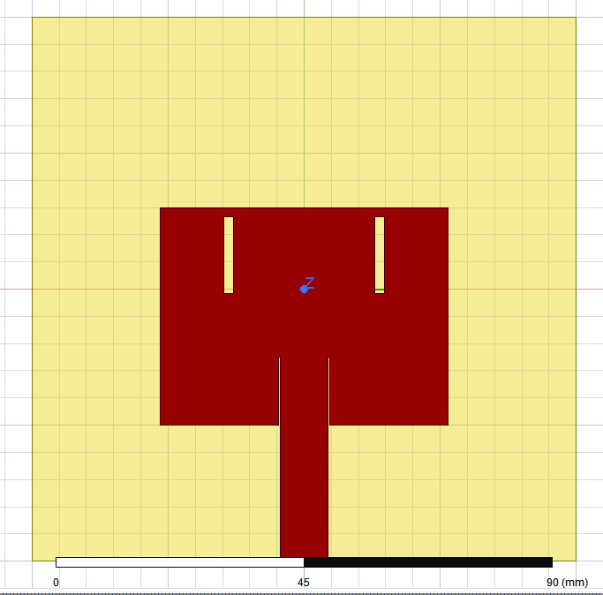
Design candidates
For all designs, FR4 epoxy is used as the substrate (ε_{r}=4.4), thickness of substrate (h) is taken as 1.6 mm, and Cu is used as the material for the patch and the ground plane. Further, thickness of Cu is taken as 0 unless stated otherwise as 0.035 mm.
A. Double slotted antenna
Design implemented from [4].
The patch is optimized to radiate at 1.8 GHz whereas the 2 slots resonate at 2.4 GHz.
Proposed antenna design. Source: [4]
Implemented design in ANSYS.

Slide 10
Design candidates
A. Double slotted antenna
A slotted dual-band frequency microstrip patch antenna operates by creating resonances at two different frequencies.
The slotted dual-band antenna has slots or openings on the patch which are designed to change the resonant frequency of the antenna. The slots create additional current paths on the patch, which interact with the electromagnetic fields and alter the resonant frequency of the antenna. By optimizing the dimensions and placement of the slots, the resonant frequency of the antenna can be shifted to a desired frequency.
The two resonant frequencies of the slotted dual-band antenna are determined by the dimensions of the patch and the slots, and can be adjusted by changing these parameters.

Slide 11
Design candidates
B. Low Profile MSPA
A low profile microstrip patch antenna with inset feeding operates at two different frequencies.
The inset feed allows for the excitation of multiple resonant modes, which are excited at different frequencies.
The patch is designed to radiate at the higher frequency (2.4 GHz).
The patch is fed by an inset feed, which is a short-circuited stub located at a specific distance from the patch edge. The inset feed allows for the excitation of multiple resonant modes, which are excited at different frequencies. (1.8 GHz in this case)
The position and dimensions of the feed and inset can optimized to obtain the desired second resonant frequency.
This design is implemented from [5].

Slide 12
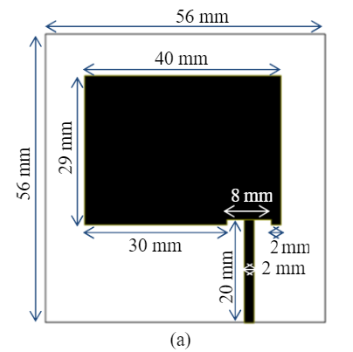
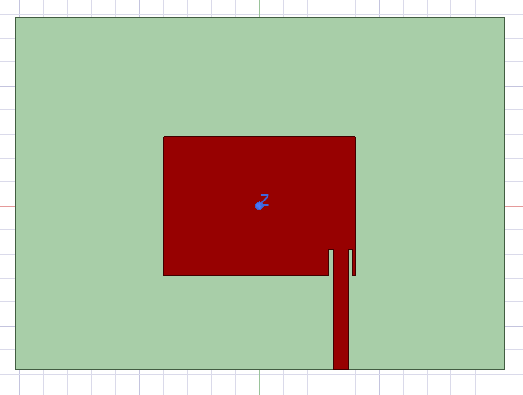
Design candidates
B. Low Profile MSPA
Proposed antenna design. Source: [5]
Design Implemented in Ansys.

Slide 13
Design candidates
C. Microstrip patch antenna with defected ground plane
Upon survey of various papers ([6], [7], [8]), we have come up with a novel design for this concept.
The defected ground plane is a technique used to improve the performance of microstrip patch antennas by creating a structure with a periodic pattern of slots or holes in the ground plane.
This structure reduces the surface waves on the ground plane and improves the radiation efficiency of the antenna.
The defected ground plane also helps to reduce the size of the antenna and improve its performance in terms of gain and radiation efficiency.

Slide 14
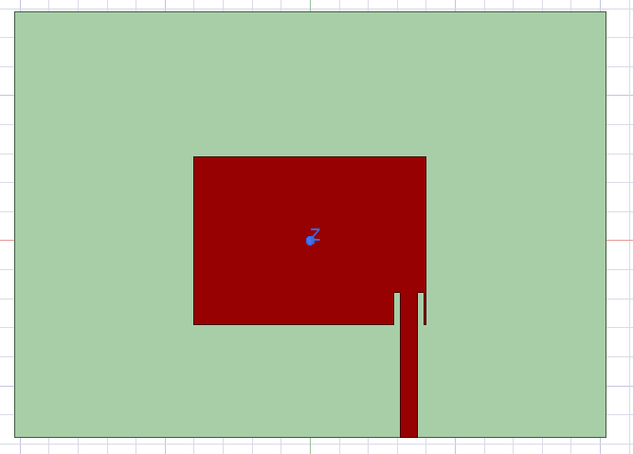
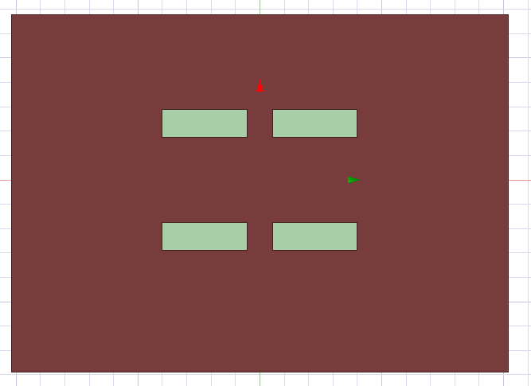
Design candidates
C. Microstrip patch antenna with defected ground plane
Top view of the design in ANSYS HFSS
Rear view of the design in ANSYS HFSS

Slide 15
Results and discussion
A. Double slotted antenna
For radiation in 1.8 GHz, the following parameter values are obtained after calculating patch dimensions from the above formulae and data obtained from the paper [4].
Parameter | Value (mm)
L | 40
W | 53
Wf (feed line width) | 8.7
Ls (vertical slot cut) | 15.5
Fi (inset slot length) | 12.5
Feed line length | 25

Slide 16
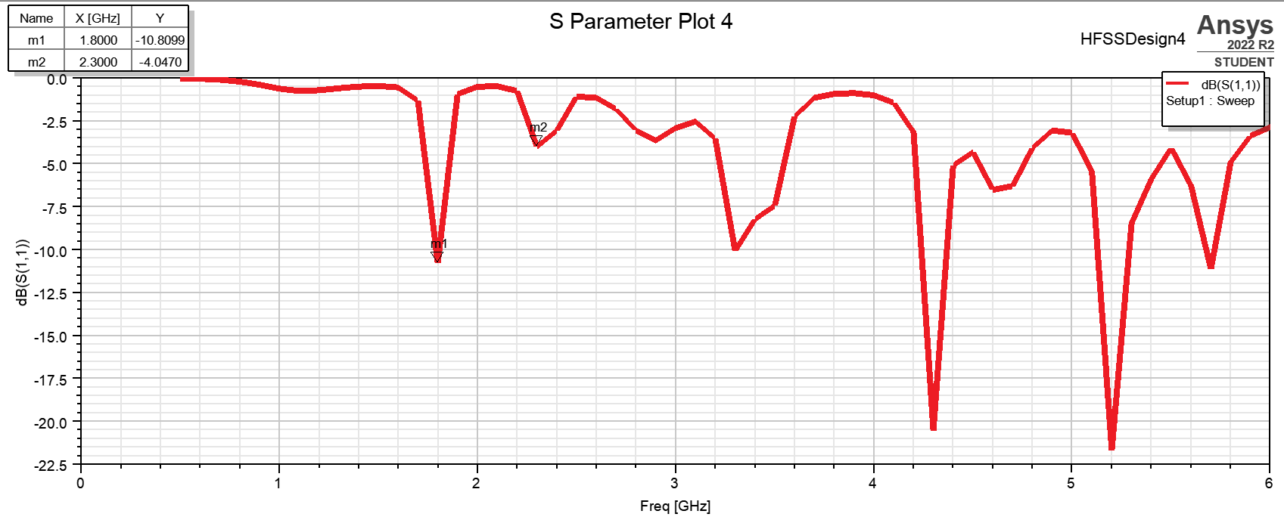
Results and discussion
A. Double slotted antenna
S parameter plot. Ideally, the S parameter value for both 1.8 GHz and 2.4 GHz should be well below -10 dB. It can be seen that the S parameter value of 2.4 GHz is -4 dB, while that of 1.8 GHz just reaches -10 dB.

Slide 17
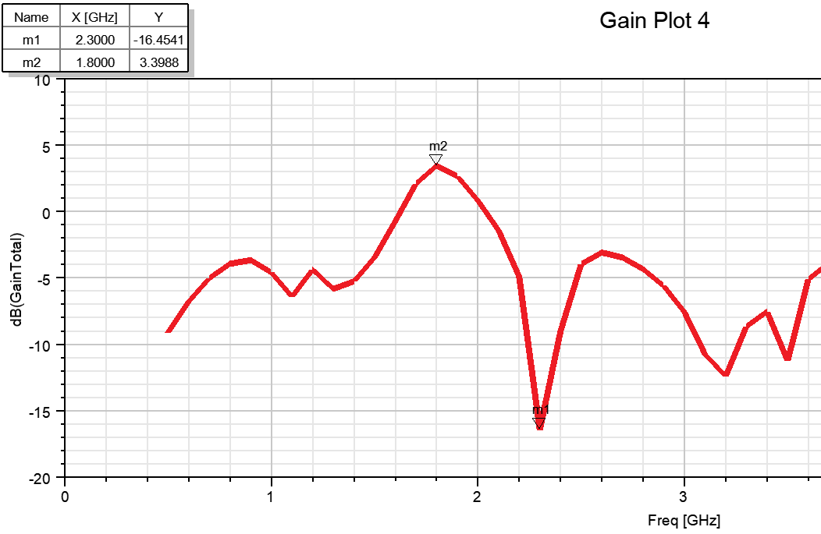
Results and discussion
A. Double slotted antenna
Gain Total plot (in dB). It can be seen that the antenna is not radiating at 2.4 GHz but has decent gain for 1.8 dB.

Slide 18
Results and discussion
A. Double slotted antenna
After this, slot length and inset cut width parameters are tuned to obtain expected results.
Parameter | Value (mm)
Ls (vertical slot cut) | 14
inset slot width | 0.4

Slide 19
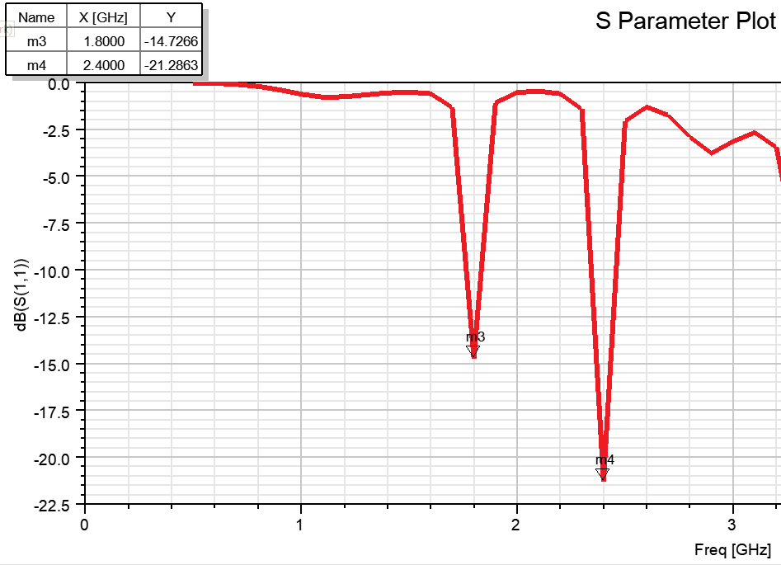
S parameter plot. Ideally, the S parameter value for both 1.8 GHz and 2.4 GHz should be well below -10 dB. It can be seen that the S parameter value of 2.4 GHz is -21.3 dB, while that of 1.8 GHz is -14.7 dB. Thus, the plot is ideal.

Slide 20
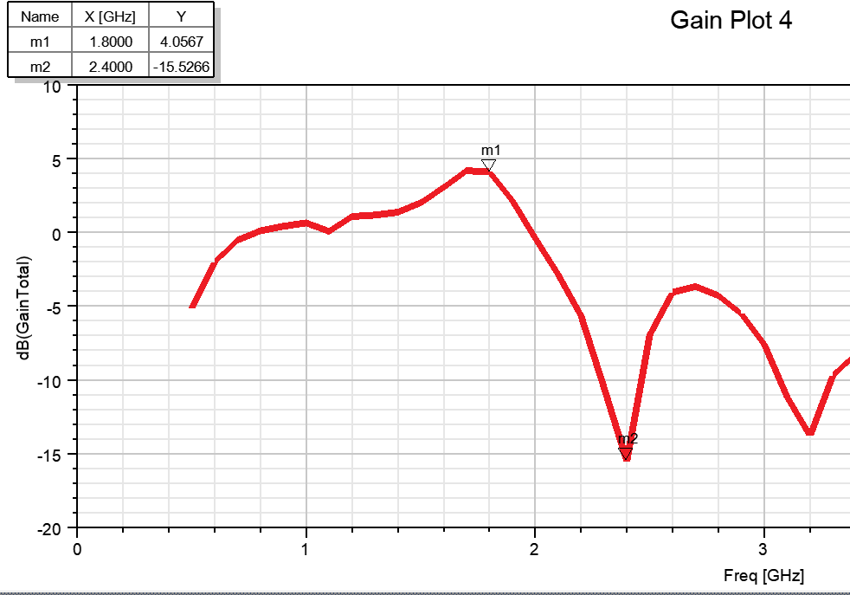
Gain Total plot (in dB). It can be seen that the antenna is still not radiating at 2.4 GHz but has decent gain for 1.8 dB.

Slide 21
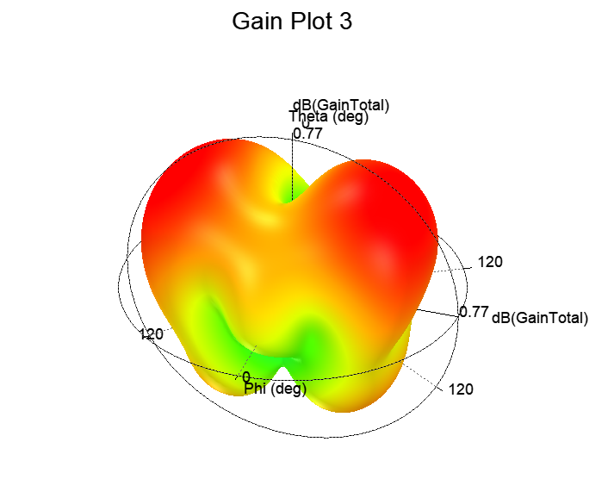
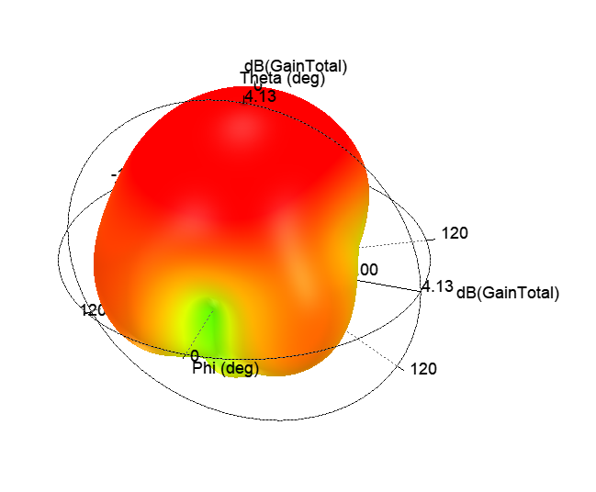
3D Gain Total plot for 2.4 GHz. It can be seen that the maximum gain is 4.13 dB in broadside direction.
3D Gain Total plot for 1.8 GHz. It can be seen that the maximum gain is 0.77 dB away from broadside direction. Thus, the antenna is not optimized for 1.8 GHz.

Slide 22
Results and discussion
B. Microstrip patch antenna (Low Profile) with Inset Feed
These are the obtained parameters after calculation and wrt to [5].
Parameter | Value (mm)
L | 29
W | 38
Wf (feed line width) | 3.1
Inset Slot Width | 1
Fi (inset slot length) | 6
Feed line length | 25

Slide 23
Results and discussion
B. Microstrip patch antenna (Low Profile) with Inset Feed
These Obtained parameters after tuning obtained are :
Parameter | Value (mm)
L | 29
W | 38
Wf (feed line width) | 3.1
Inset Slot Width | 1
Fi (inset slot length) | 5.541
Feed line length | 30

Slide 25
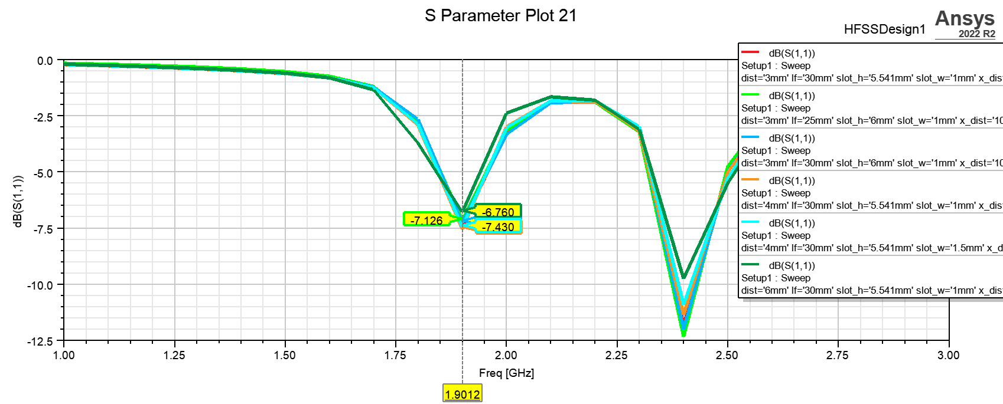
S parameter plot for different combinations of slot height, slot width and feed distance from edge. The value at 2.4 GHz is below -10 dB, however for all combinations there is a dip around 1.9 GHz rather than 1.8 GHz, which does not reach -10 dB.

Slide 26
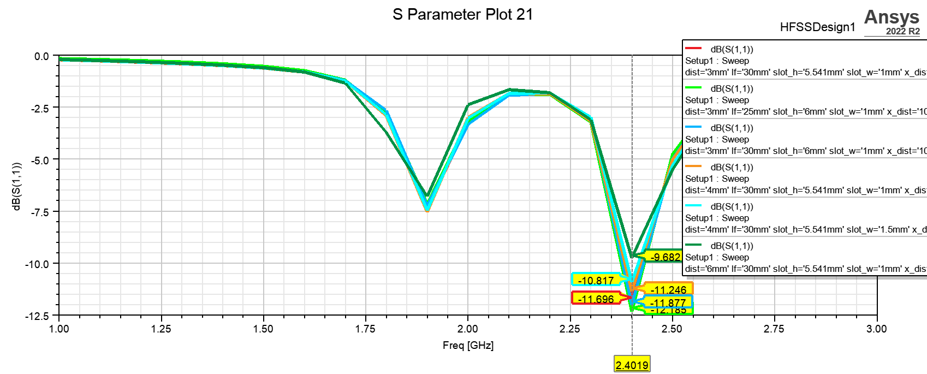
S parameter plot for different combinations of slot height, slot width and feed position, We can observe that for 2.4 GHz the return loss abs. is greater than 10dB for almost all cases. Thus optimization is required for 1.8 GHz

Slide 27
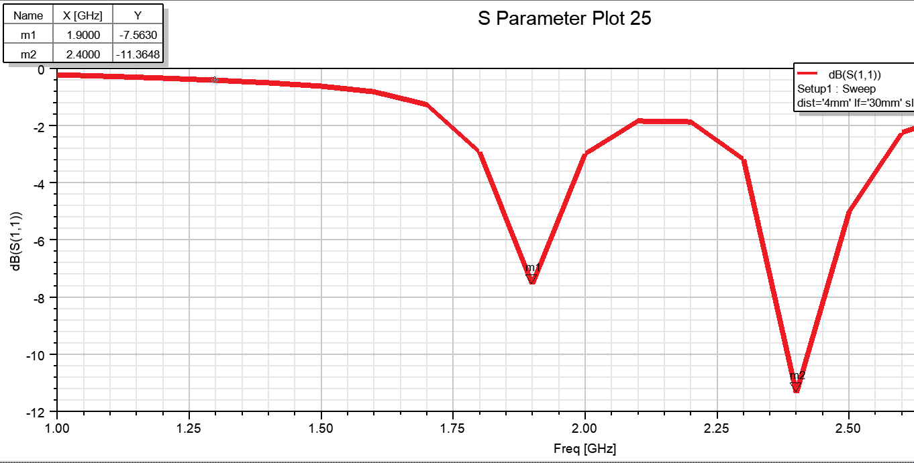
S parameter plot for best optimal parameters. The value at 2.4 GHz is below -10 dB, however for all combinations there is a dip around 1.9 GHz rather than 1.8 GHz, which does not reach -10 dB.

Slide 28
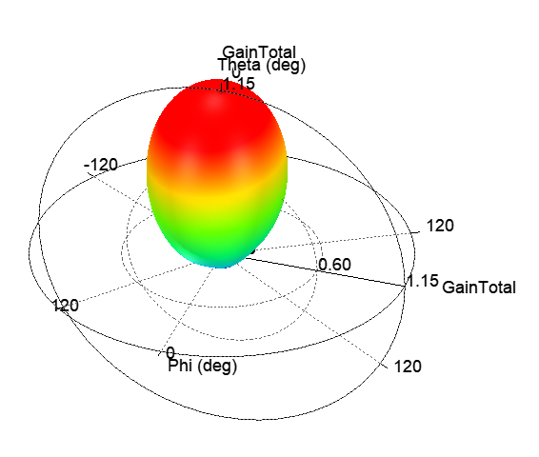
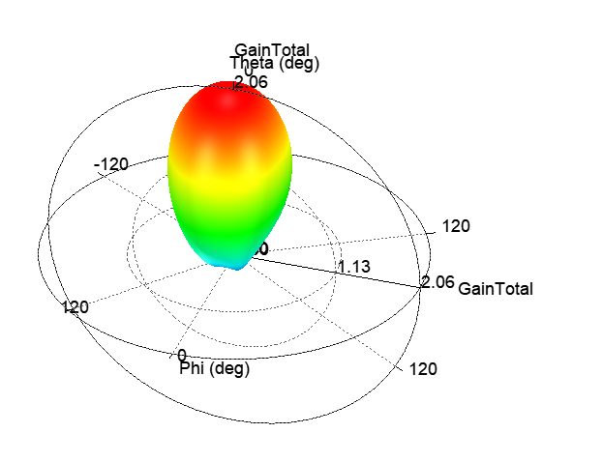
3D polar plot for best optimal parameters. The value at 2.4 GHz is below 2.06 dB in broadside and for 1.8 GHz in 2.06 dB. Thus, the gain obtained are still close to each other and radiating.

Slide 29
Results and discussion
C. Microstrip patch antenna with defected ground plane
These are the final optimized parameters:
Parameter | Value (mm)
L | 29
W | 40
Wf (feed line width) | 3.1
Fi (inset slot length) | 5.541
Inset slot width | 1
Feed line length | 25
Distance of feed from edge | 3
Ground plane slot width | W/2.3 = 17.39
Ground plane slot length | L/5 = 5.8

Slide 30
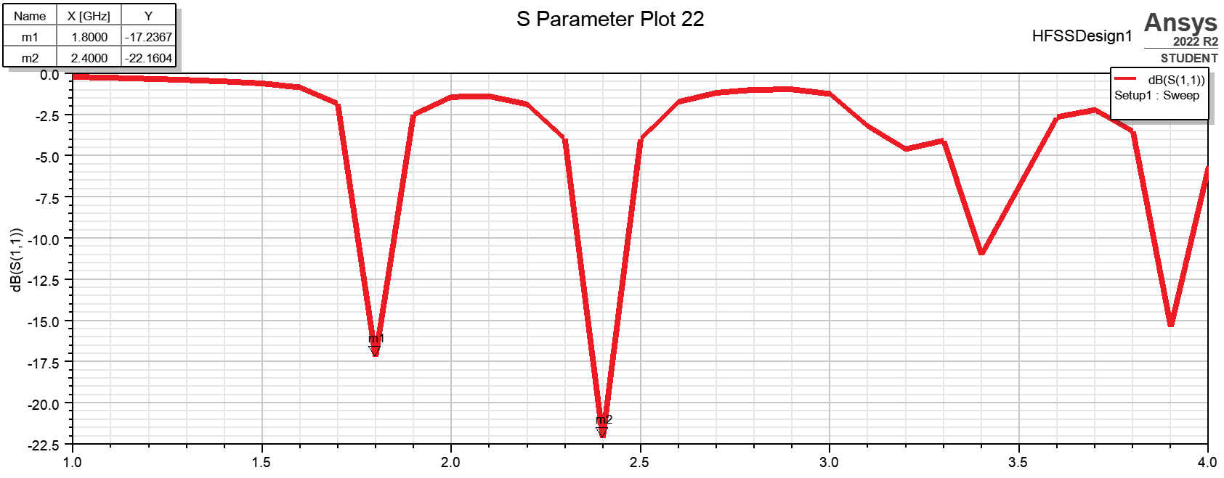
S parameter plot. Ideally, the S parameter value for both 1.8 GHz and 2.4 GHz should be well below -10 dB. It can be seen that the S parameter value of 1.8 GHz is -17.23 dB, while that of 2.4 GHz is -22.16 dB. Thus, the plot is ideal.

Slide 31
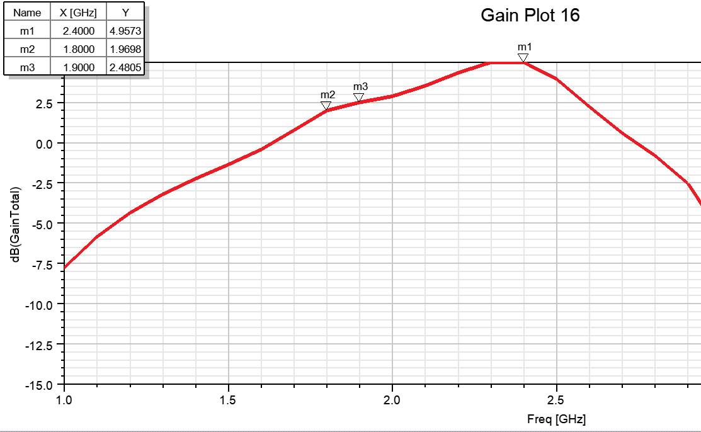
Gain Total plot (in dB). The gain at 2.4 GHz is 5 dB and the gain at 1.8 GHz is 2. Even though the gain is not 3 dB at 1.8 GHz, the proof of concept has been verified for this antenna design.

Slide 32
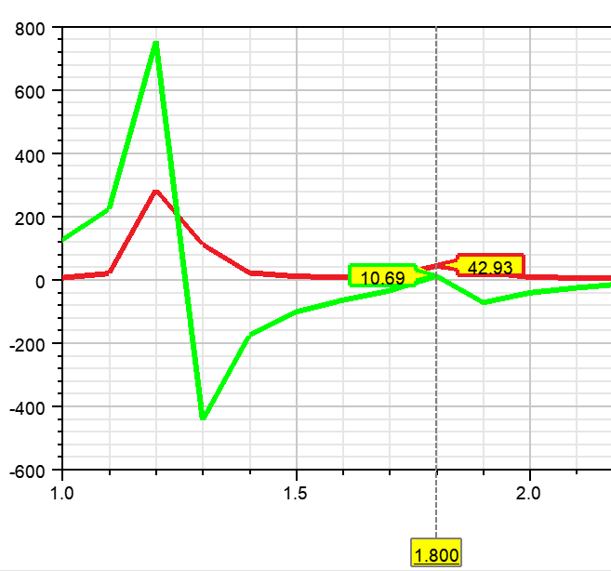
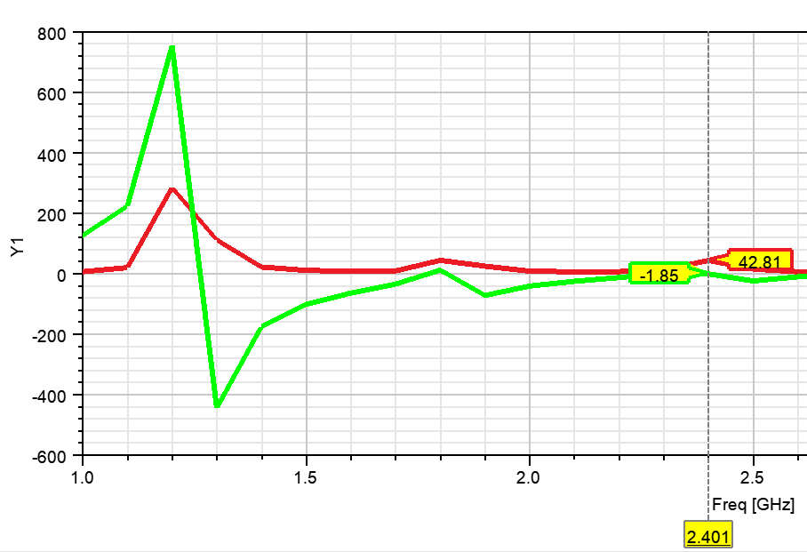
Z parameter, Real(Red) and Imaginary(Green)
Real Parameter for both frequencies is close to 50 ohms relating to impedance matching and imaginary part is close to 0.

Slide 33
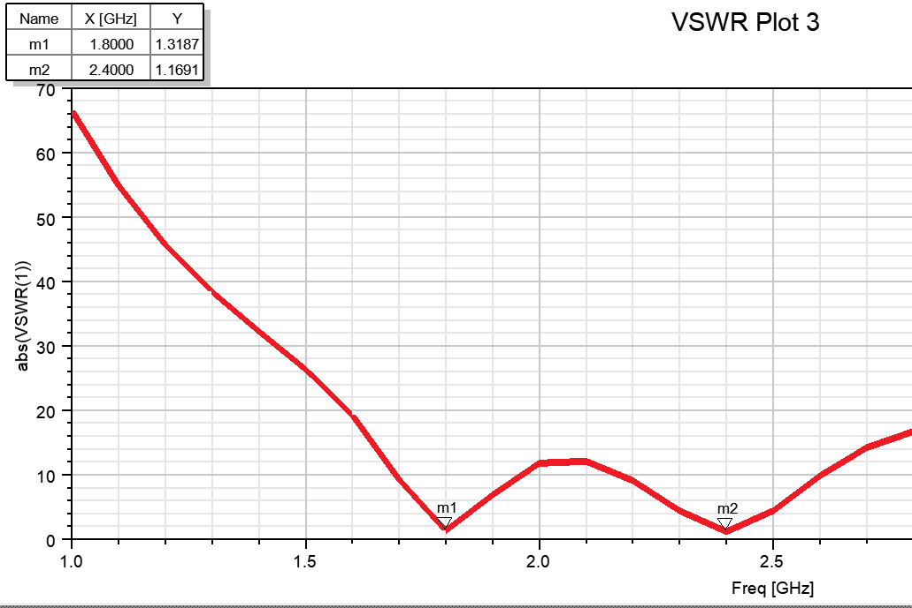
VSWR Plot: The Plot for VSWR in general should be less than 2. For 2.4 GHz, It is 1.16 and for 1.8 GHz, it is 1.31 which are both acceptable.

Slide 34
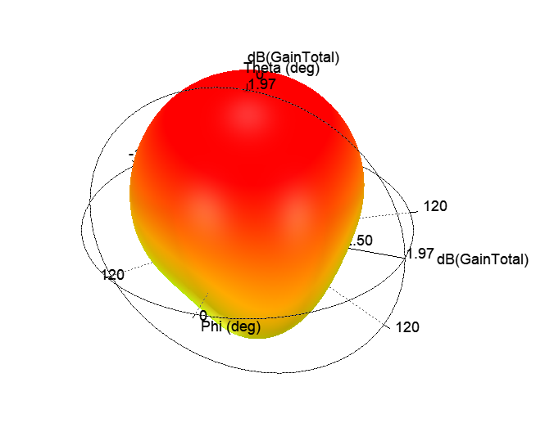
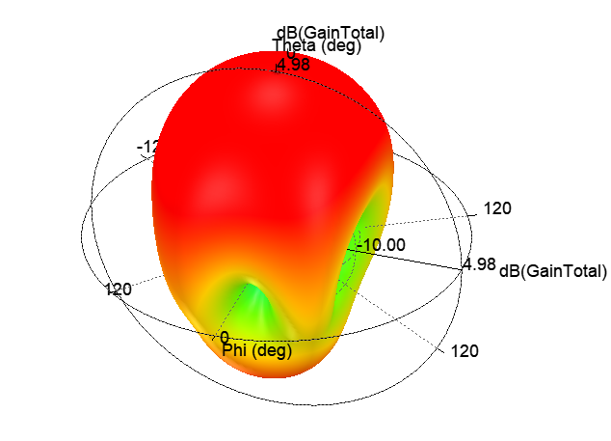
3D Gain Total plot for 1.8 GHz. It can be seen that the maximum gain is 1.97 dB in broadside direction.
3D Gain Total plot for 2.4 GHz. It can be seen that the maximum gain is 4.98 dB in broadside direction.

Slide 35
Conclusion and future work
After testing various antenna designs, it has been determined that the microstrip patch antenna with defected ground plane works best for dualband radiation in 1.8 GHz and 2.4 GHz.
The S parameter plot shows respectable results for both frequency ranges. Gain for 1.8 GHz is around 2 dB and for 2.4 GHz, it is around 5 dB. Thus, there is scope for further improvement of the 1.8 GHz gain to 3 dB by testing different patterns of ground plane defects.

Slide 36
References
[1] https://www.iexplainall.com/2020/05/design-equations-of-rectangular.html
[2] Balanis, C., 2005. Antenna theory. New York: Wiley-Interscience.
[3] https://www.everythingrf.com/rf-calculators/microstrip-width-calculator
[4] A. A. A. Alsaleh, M. R. Islam, M. A. W. Nordin and S. Al-Askari, "Design and Optimization of Dual Band Microstip Patch Antenna Using Slots Pair," 2016 International Conference on Computer and Communication Engineering (ICCCE), Kuala Lumpur, Malaysia, 2016, pp. 439-442.
[5]A low profile rectangular patch microstrip antenna for dual-band operation of wireless communication system. IOP Conference Series Materials Science and Engineering 309(1):012046
[6] Kaur, J., & Khanna, R. (2014). Development of dual-band microstrip patch antenna for WLAN/MIMO/WIMAX/AMSAT/WAVE applications. Microwave and Optical Technology Letters, 56(4), 988–993.
[7] Ali, Imad & Chang, Ronald. (2015). Design of Dual-Band Microstrip Patch Antenna with Defected Ground Plane for Modern Wireless Applications. 1-5. 10.1109/VTCFall.2015.7390887.
[8] Gautam, A. K., Bisht, A., & Kanaujia, B. K. (2016). A wideband antenna with defected ground plane for WLAN/WiMAX applications. AEU-International Journal of Electronics and Communications, 70(3), 354-358.

